Slide 1
Our Work: STEM Programs
Alexandria Clark, Intern
Office of Economic Impact and Diversity
energy.gov/diversity
Notes:
Agenda- 10 min overview of DOE’s work and challenges, and the ways that states participate in them.

Slide 2
What is STEM?
Department of Energy Science, Technology, Engineering, and
Mathematics (STEM) education activities include
curriculum development, competitions, summer and
extracurricular course creation, undergraduate &
graduate research fellowships, summer laboratory
internships, teacher training, and others.

Slide 3
Objectives of STEM Activity Programs
Attract and prepare students at any educational level to pursue coursework in STEM areas through formal or informal education activities
Improve or expand the capacity of institutions to promote or foster education in STEM fields
Attract graduates to pursue careers in STEM fields
Provide training and experiential opportunities (fellowships, internships, traineeships) for college and graduate students in STEM fields
Improve teacher (pre-service, in-service, and post-secondary) education in STEM areas

Slide 4

Student Educational Resources
Energy Literacy
- Essential Principles and Fundamental Concepts for Energy Education identifies seven Essential Principles and a set of Fundamental Concepts to support each principle. It presents energy concepts that, if understood and applied, will help individuals and communities make informed energy decisions.
America’s Home Energy Educational Challenge
- With sponsoring from the US Department of Energy and the National Science Teachers Association , this program gives students the chance “to learn about energy, develop techniques for reducing energy consumption, and save money in their own homes by reducing household energy use.” Deadline for registration : November 18, 2013.
Energy Kids
- a site run by the U.S. Energy Information Administration, has a wide range of activities for students and information about how teachers can put this site to use.
See more at: http://energy.gov/diversity/student-educational-resources-stem

Slide 5
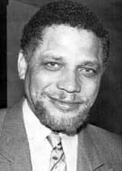
STEM Internships, Fellowships, and Mentorships
Minority Educational Institution Student Partnership Program (MEISPP)
Offers talented undergraduate and graduate students summer internship positions with the
Department of Energy and our National Laboratories, with the goal of reaching underrepresented
students in STEM fields, such as women and girls. Positions involve scientific research or a focus
on policy, business, and government relations. Deadline for application submission in
March.
Mickey Leland Energy Fellowship
The Mickey Leland Energy Fellowship (MLEF), sponsored by the U.S. Department of
Energy's Office of Fossil Energy, is a 10-week summer internship program that
provides opportunities to students who are pursuing degrees in science, technology
(IT), engineering, or mathematics (STEM majors). The goal of the program is to
Improve opportunities for minority and female students in these fields, but all
eligible candidates are encouraged to apply. Candidates who are selected will have the
opportunity to work on focused research projects consistent with the mission of the
Office of Fossil Energy. Deadline for application in January.

Slide 6
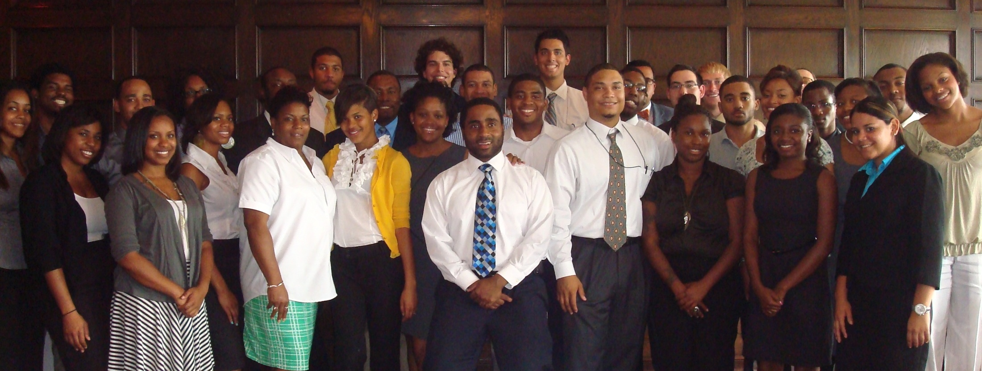
Minority Educational Institution Student Partnership Program
Gain 10 weeks of substantive professional and technical career experience while working side-by-side with an assigned mentor who is a subject matter expert. Mentors help students tailor their practical work experience to their professional interests.
For more information: http://www.doeminorityinternships.org
Notes:
Image shown is Monument Valley, Utah, on Navajo Land
To promote science education and research among American Indian college students and faculty at TCUs and mainstream institutions with significant enrollment of American Indian students and/or active AISES chapters.
Integrate DOE and National Laboratory science resources into the national American Indian STEM educational infrastructure
Engage American Indian college students in relevant and exciting applied research engineering, and technology transfer projects conducted on Tribal Lands.

Slide 7
STEM Internships, Fellowships, and Mentorships cont.
The American Indian Research and Education Initiative
- Introduced in 2011, the Energy Department, the American Indian Higher Education Consortium and the American Indian Science and Engineering Society have partnered to bring STEM research and education funding to our nation’s Tribal colleges and universities and other U.S. universities around the country. This program funds student and faculty research teams to bring energy projects to tribal land.
Clean City Workforce Development Program
- Clean Cities, in the Office of Energy Efficiency and Renewable Energy (EERE) Vehicle Technologies Program, offers students across the country the opportunity to work with community-based Clean Cities coalitions. Students can work on a variety of projects that reduce petroleum in the transportation sector, including communication on alternative fuels, fleet analysis, and stakeholder outreach.
See more at: http://www1.eere.energy.gov/cleancities/toolbox/internship_program.html

Slide 8
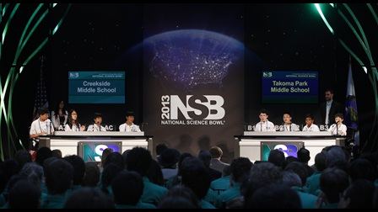
Competitions: Student STEM Contests and Events
The U.S. Department of Energy Solar Decathlon
This challenges collegiate teams to design, build, and
operate solar-powered houses that are cost-effective,
energy-efficient, and attractive. The winner of the
competition is the team that best blends affordability,
consumer appeal, and design excellence with optimal
energy production and maximum efficiency.
The National Science Bowl
Allows high school and middle school students to
participate in a nation-wide competition to test their
knowledge of STEM fields and encourage students to
explore careers in STEM. High school and middle
school students are quizzed in a fast paced question-
and-answer format similar to Jeopardy. National
Event: April 24 – 28, 2014
The Collegiate Wind Competition
- sends undergraduate students through a multi-part challenge that will expose them to a variety of opportunities in clean energy. Beginning in 2013, student teams from 10 universities across the country will design and construct a lightweight, transportable wind turbine that can be used to power small electronic devices.
The National Clean Energy Business Plan Competition
- designed to build regional networks of student-focused business creation contests across the country. Launched in 2011, the NCEBPC is part of the Obama Administration's Startup America Initiative, the White House campaign to inspire and promote entrepreneurship. Six regional organizations were funded under the competition to hold clean energy business plan competitions.

Slide 9
STEM Education Opportunities: Grads & Researchers
Graduate Automotive Technology Education
- this DOE program helps universities sponsor student fellowships and develop graduate-level curricula, with accompanying research, in five critical technology areas: fuel cells, hybrid drive trains and control systems, lightweight materials, direct-injection engines, and advanced energy storage.
Computational Science Graduate Fellowship Program
- provides outstanding benefits and opportunities to students pursuing doctoral degrees in fields of study that use high performance computing to solve complex science and engineering problems. application for 2014-2015 will be available late October 2013.
The Stewardship Science Graduate Fellowship Program
- designed to help exceptional graduate students earn their PhDs in areas of interest to stewardship science, such as high-energy density physics, low-energy nuclear science, or properties of materials under extreme conditions. Deadline August 2014
Energy Efficiency and Renewable Energy Science and Technology Policy Fellowship
- serve as the next step in the educational and professional development of leaders in energy efficiency and renewable energy policy, providing an opportunity for scientists and engineers with relevant energy technology experience to participate in policy-related projects at DOE's Office of Energy Efficiency and Renewable Energy in Washington, D.C
For more information see: http://energy.gov/diversity/services/stem-education/stem-education-opportunities-grads-researchers

Slide 10
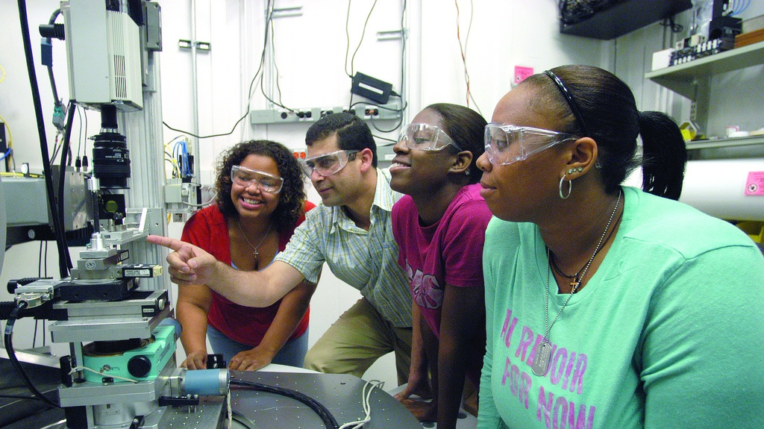
Student Training
Diverse students come to National Laboratories and DOE headquarters to work with researchers and scientists.
For more: http://energy.gov/scholarships&internships.htm
Notes:
MEISPP program in ED, 10 weeks here and at our labs
Community College Institute for science and technology – 10 weeks, mentor matches and new FY 11 partnership with TCUs
Office of Science Grad Fellowship SCGF supports outstanding students in the pursuit of graduate training in basic research in areas relevant to the Office of Science and encourages the development of the next generation scientific and technical talent in the U.S.

Slide 11
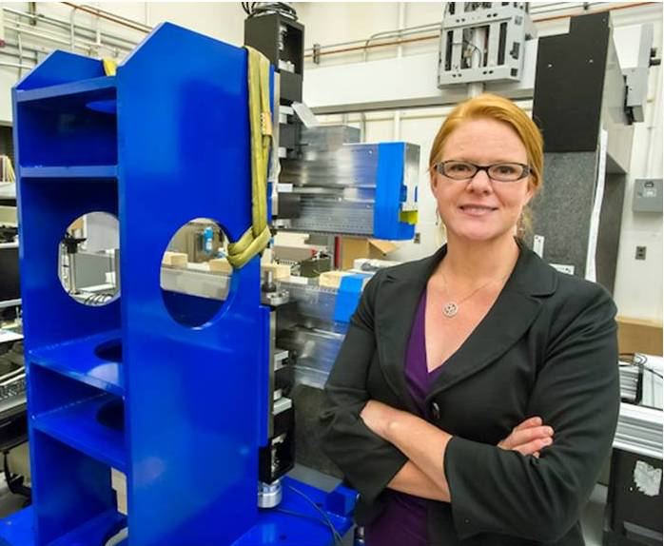
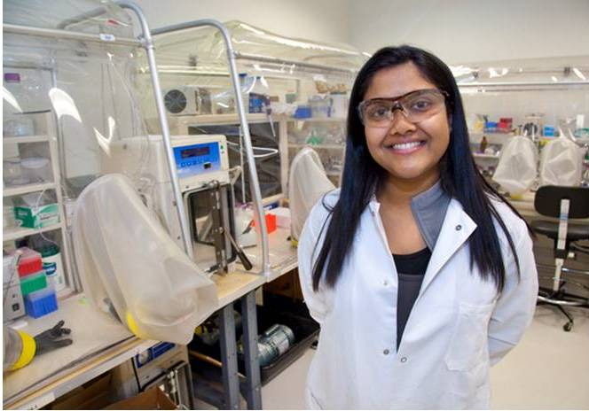
Women @ Energy
Our new feature, Women @ Energy, showcases a few of our talented and dedicated employees at the Department of Energy who are helping change the world, ensuring America’s security and prosperity through transformative science and technology solutions.
Only 24% of the STEM workforce is female, an alarming gap as over 51% of the workforce overall is female.
View over 100 profiles of women across the country, sharing what inspired them to work in STEM, what excites them about their work at the Energy Department, sharing ideas for getting more underrepresented groups engaged in STEM, offering tips, and more.
More information at: http://energy.gov/diversity/listings/women-energy

Slide 12
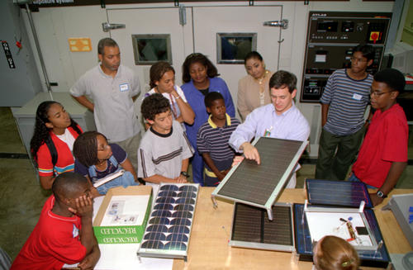
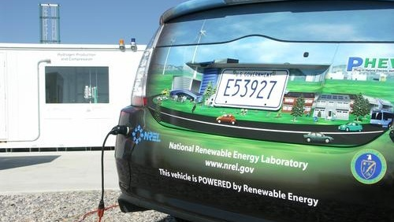
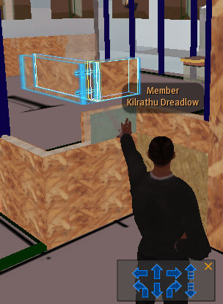
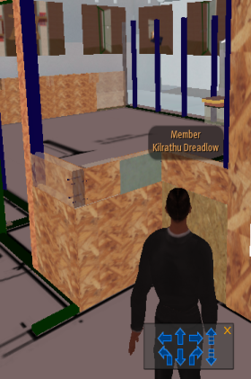
EERE’s Education and Workforce Development Subprogram
Goals:
Education: Beginning at the K-12 level, ensure ongoing development of a workforce needed to carry out invention and scale-up of EERE technologies and processes
Training: Ensure creation of standardized, high-quality training programs including credentialing activities for workers to meet current EERE needs in all sectors of the economy;
IT: Design and deploy advanced learning technologies that will enable high quality education and training materials and programs to be created rapidly, updated and made routinely available.
12

Slide 13
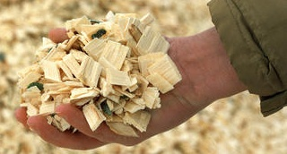
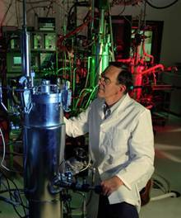

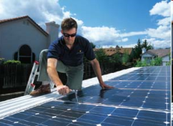
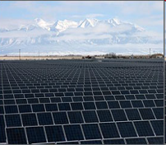
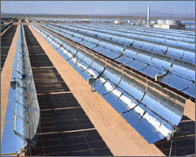

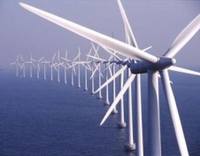
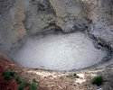

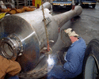

Thank You
Alexandria Clark
diversity@hq.doe.gov
Office of Economic Impact and Diversity, MESIPP Intern
Notes:
13

